Slide 1
Persistence w/ Spring Data
February 2019

Slide 2

Spring Data
Provides a familiar and consistent, Spring-based programming model for data access while still retaining the special traits of the underlying data store.
It makes it easy to use data access technologies, relational and non-relational databases, map-reduce frameworks, and cloud-based data services.
Notes:
Primary goal of the “Cloud Native Development” track is to introduce the audience to Spring Boot.

Slide 3
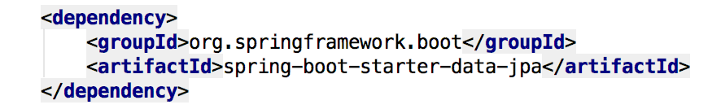
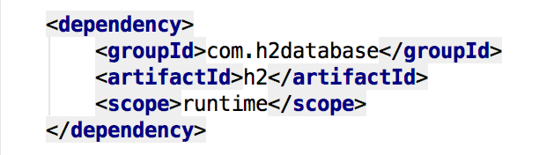
Spring Data JPA
Add the Spring Data JPA starter to our pom.xml file
Sprinkle a database connector into our pom.xml

Slide 4
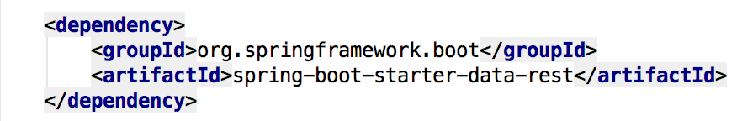
Spring Data REST
Goal is to provide a solid foundation on which to expose CRUD operations on our repository managing entities using plain HTTP REST semantics
Add a dash of Spring Data REST starter into our pom.xml

Slide 5
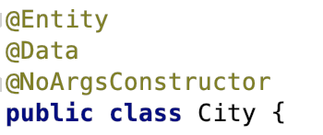

Spring Data JPA - @Entity & Repository
Annotate your entity class with @Entity
Create a JPA Repository to manage our @Entity
Notes:
Primary goal of the “Cloud Native Development” track is to introduce the audience to Spring Boot.

Slide 6
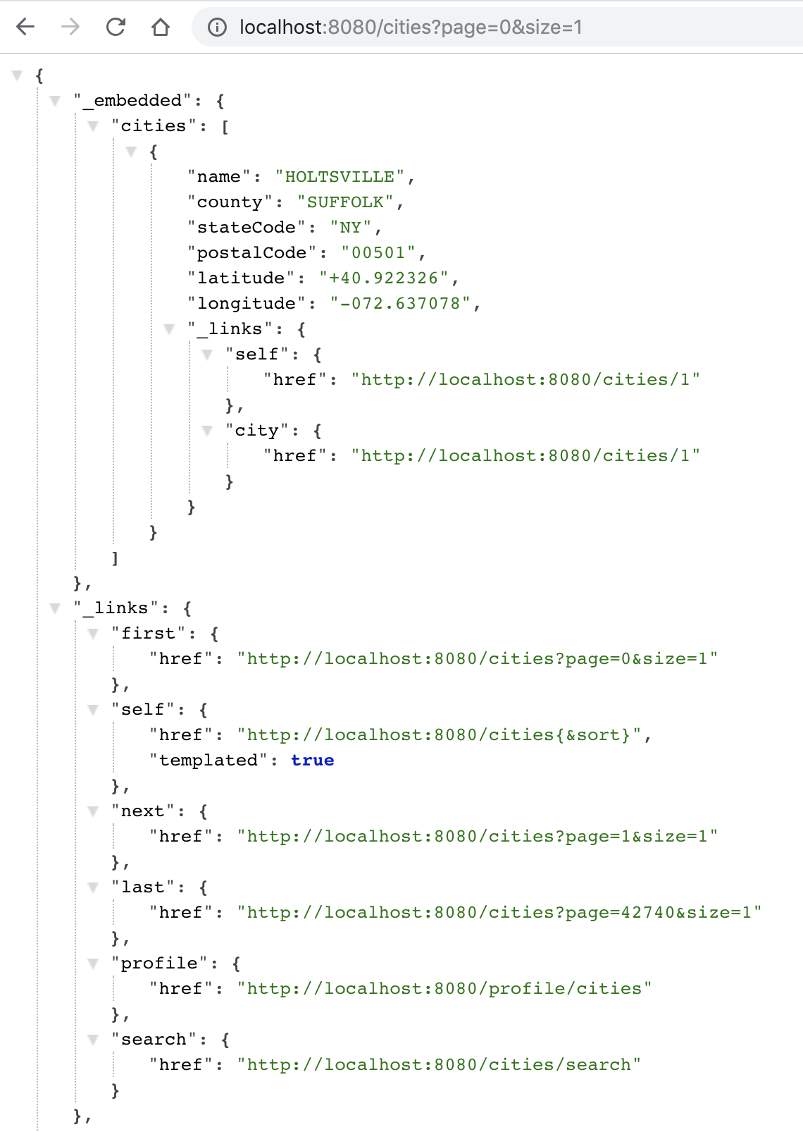
Spring Data REST
Spring Data REST builds on top of Spring Data repositories, analyzes your application’s domain model and exposes hypermedia-driven HTTP resources for aggregates contained in the model
Spring Data REST makes it easy to build hypermedia-driven REST web services on top of Spring Data repositories
For this repository, Spring Data REST exposes a resource collection at “/cities”

Slide 7
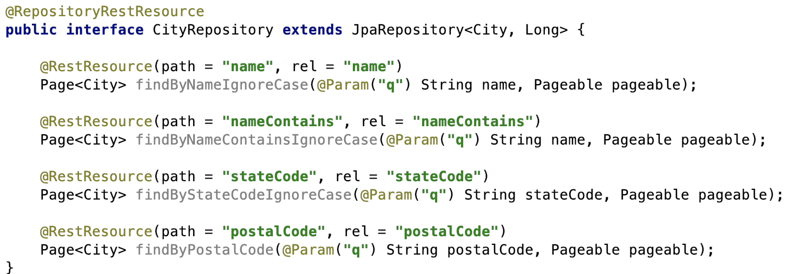
Supports Search, findBy*

Slide 8
Questions
What is your most common data persistence target?
How do you abstract your app from underlying data tier?
How do you handle version changes of database in your app?

Slide 9

Transforming How The World Builds Software
© Copyright 2017 Pivotal Software, Inc. All rights Reserved.

